Slide 1

VisionGuard360

Slide 2

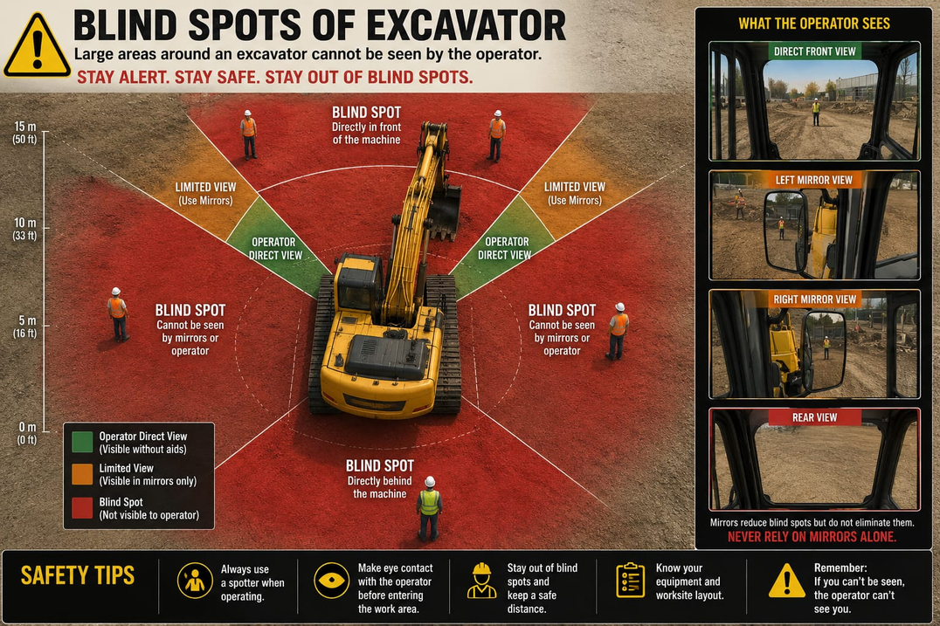
Problem Statement :
Excavator blind-spot radar / vehicle blind spot detector: Mount ultrasonic/radar sensors around heavy machinery to create a 360° proximity alert system that warns operators of nearby workers via cabin buzzer and LED ring.

Slide 3

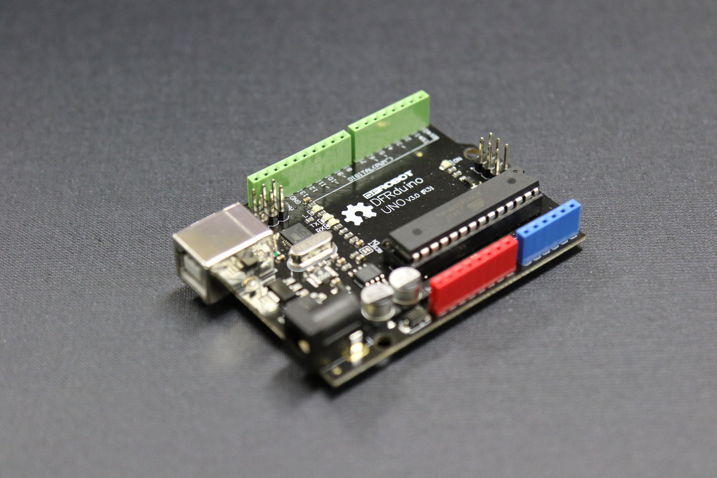
Objective/Solution :
Create a low-cost and reliable safety The main objective of this project is to develop a 360° blind-spot detection and proximity warning system for heavy vehicles or excavators using ultrasonic/radar sensors.
The system aims to:
1. Detect workers, obstacles, or vehicles present in the blind spots around heavy machinery.
Improve safety at construction sites, mining areas, and industrial environments.
Alert the operator through a buzzer and lLED indicators whenever a person or object comes close to the vehicle

Slide 4
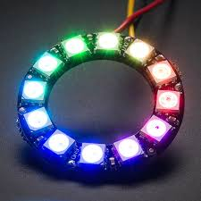
4. Reduce accidents caused by limited visibility around large machines.
5. Provide real-time monitoring of the surroundings for safer machine operation
solution using sensors and embedded systems.

Slide 5

Features
• 360° blind-spot monitoring
• Real-time obstacle detection
• Audio alert using buzzer
• Visual warning using NeoPixel LED ring
• Low-cost safety system
• Easy installation on heavy vehicles

Slide 6
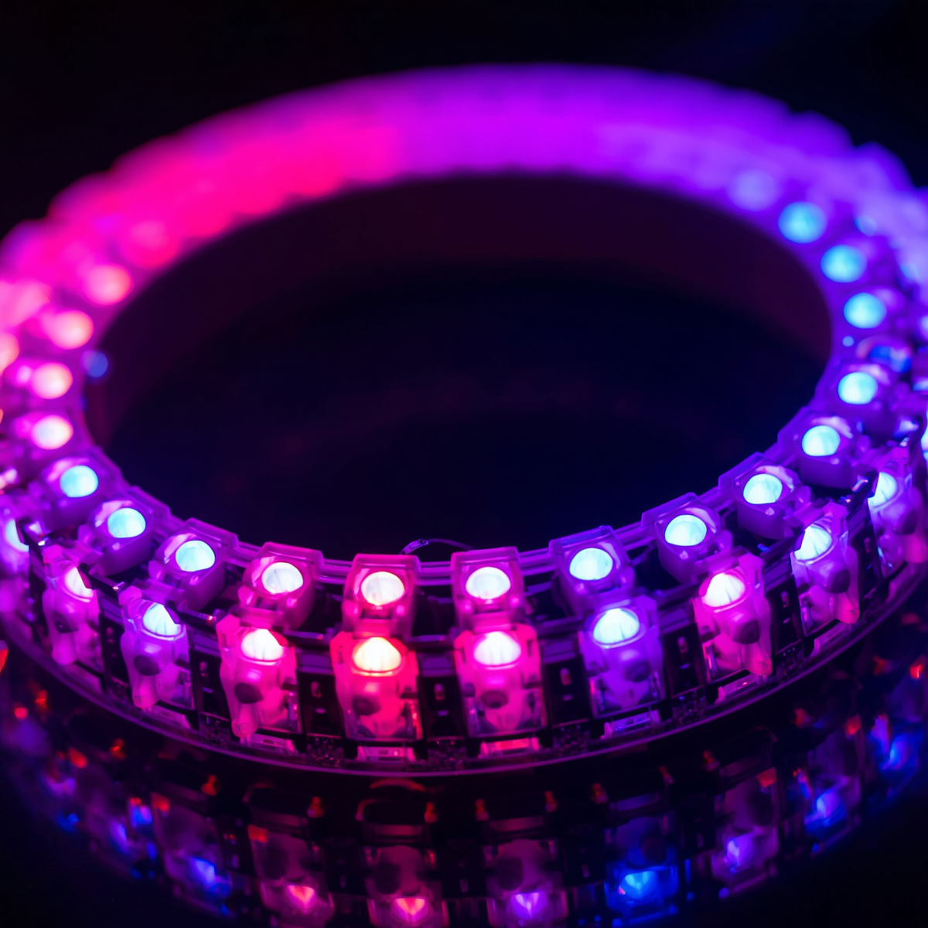
Components Used :
1.Ultrasonic sensor (HC-SR04) -4
2.Arduino Uno R3 -1
3.Buzzer (Piezo) -1
4.NeoPixel led ring 16 -1
5.Jumper wire

Slide 7
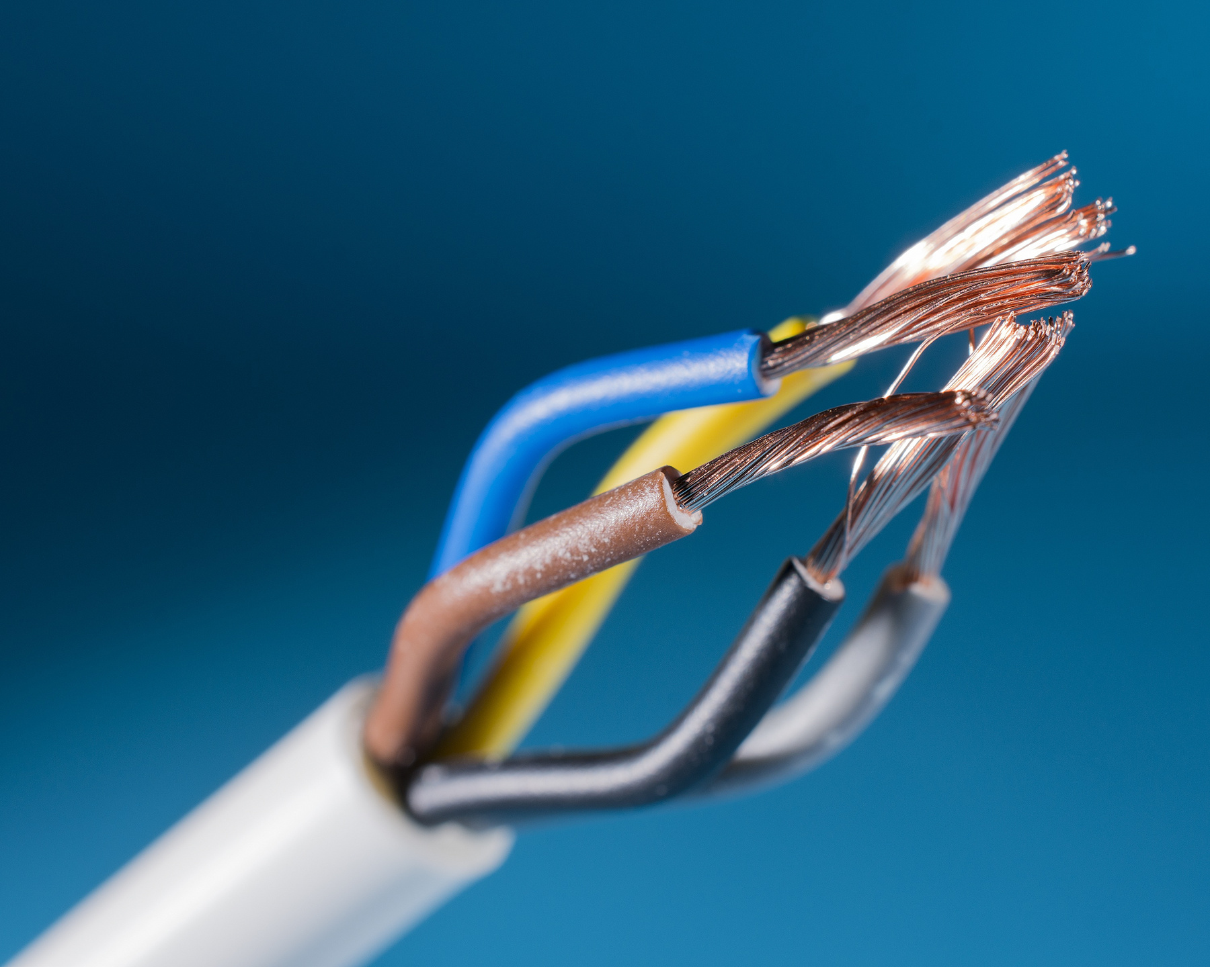
How it works ???
1. HC-SR04 Ultrasonic Sensor (Quantity – 4)
These sensors detect nearby objects around the vehicle.
They send ultrasonic waves and receive the reflected waves to measure the distance between the vehicle and obstacles in blind spots.
2. Arduino Uno R3 (Quantity – 1)
It acts as the brain of the system.
It receives data from all ultrasonic sensors, processes the distance values, and controls the buzzer and LED ring based on obstacle detection.

Slide 8
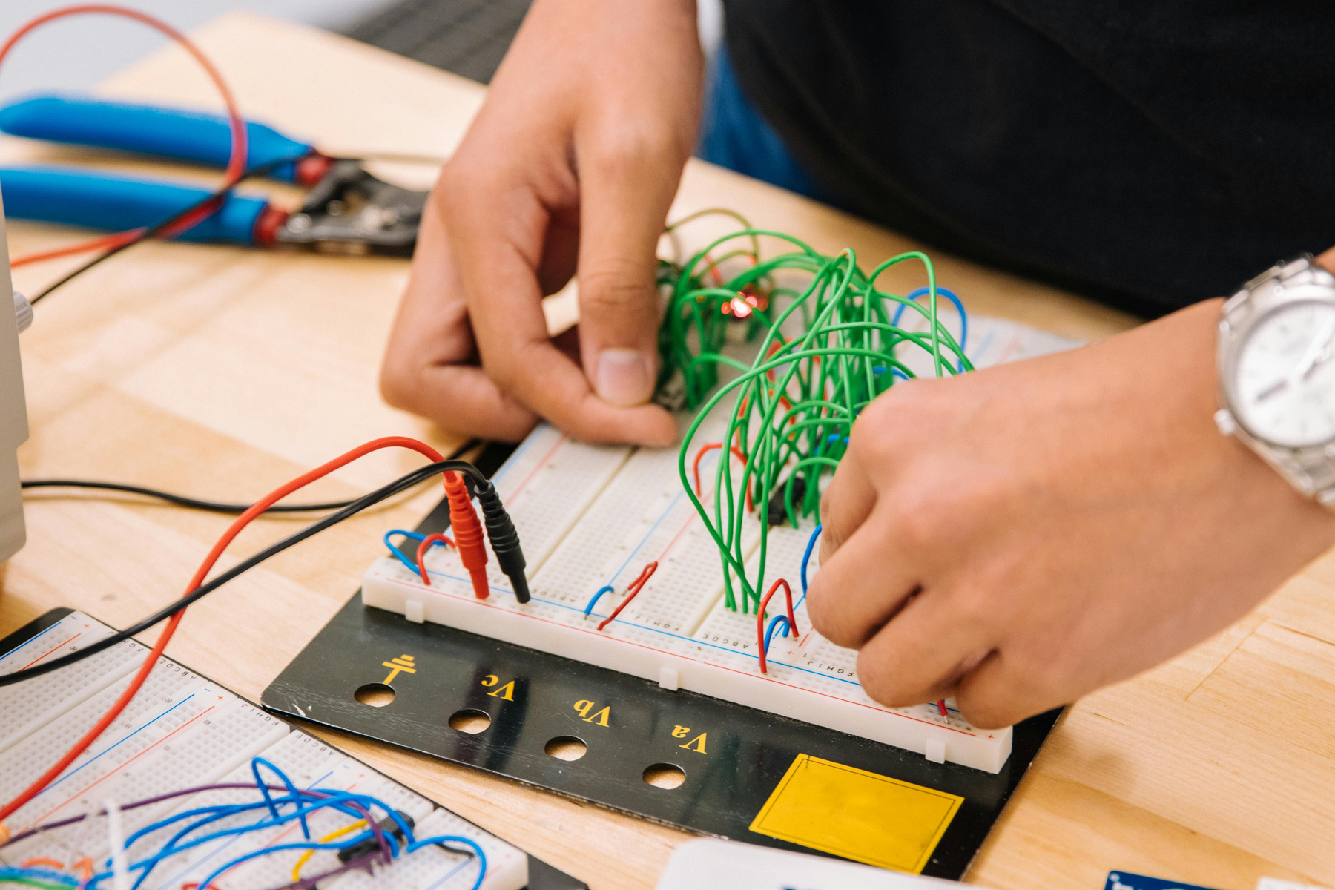
3. Piezo Buzzer (Quantity – 1)
The buzzer gives a warning sound when an object or person comes too close to the vehicle, alerting the operator about danger.
4. NeoPixel LED Ring 16 (Quantity – 1)
The LED ring provides visual alerts.
Different LEDs glow or change color depending on the distance of the obstacle from the vehicle.
5. Jumper Wires
Jumper wires are used to connect all the components together and allow signals and power to pass between the Arduino, sensors, buzzer, and LED ring.

Slide 9
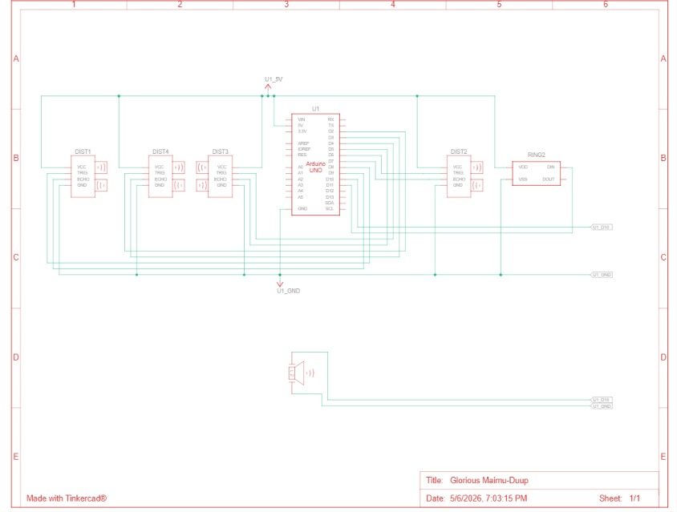
Circuit Diagram

Slide 10
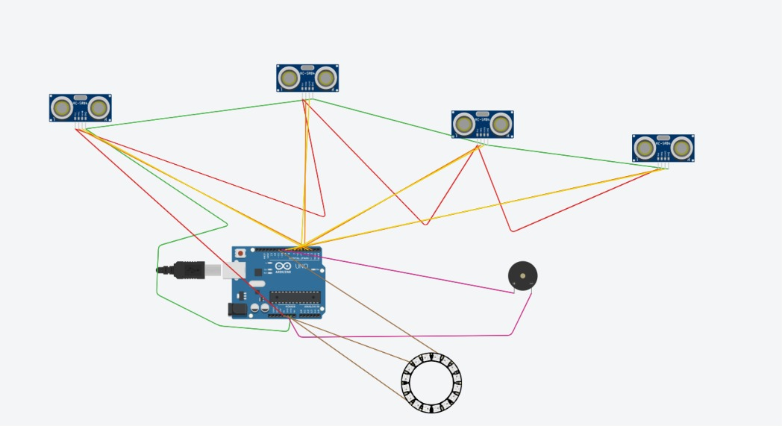
Circuit Diagram

Slide 11
Future Scope
1.Integration with AI and cameras for better object recognition.
2.Mobile app connectivity for remote monitoring and alerts.
3.GPS and IoT support for real-time tracking and safety monitoring.
4.Automatic braking system to prevent collisions.
5.Use in construction vehicles, mining equipment, trucks, and smart
6.Transportation systems.
7.Improved accuracy using advanced radar and sensor technologies.

Slide 12
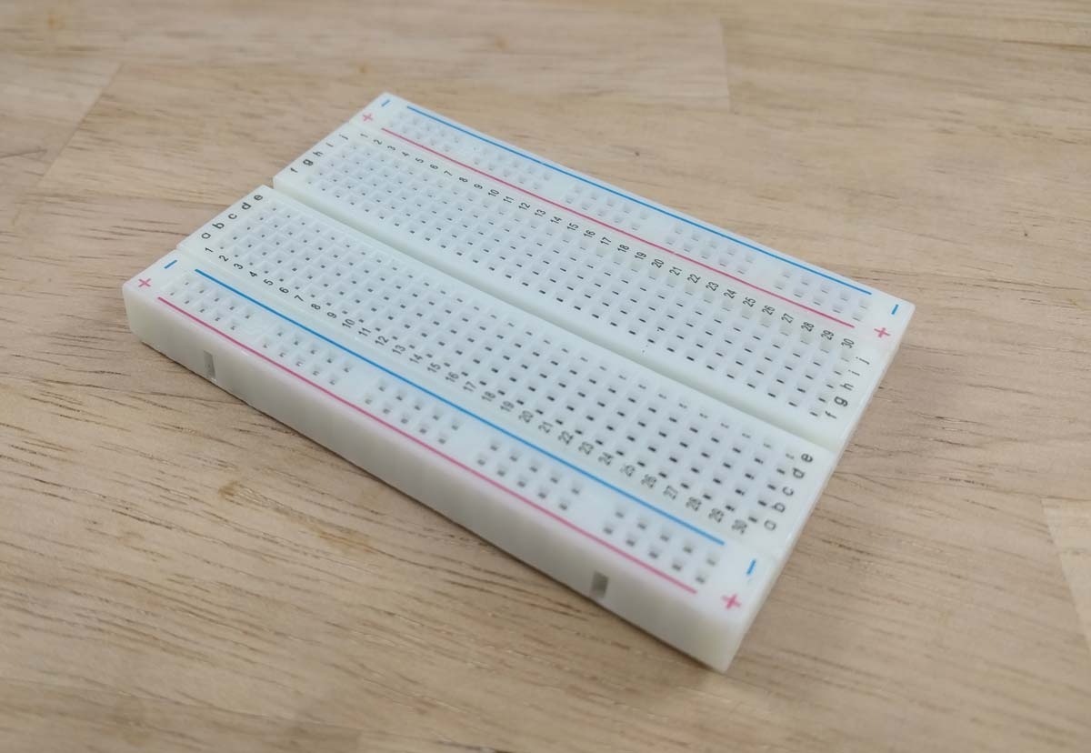
Advantages
1.Provides 360°obstacle detection
2.Reduces blind-spot accidents
3.Improves operator safety
4.Real-time monitoring
5.Low-cost implementation
6.Easy to install and maintain
7.Portable and scalable design

Slide 13

Team Members:
M.BHAVANA
MUMMADI REDDY RISHIKA
VENKAT KARTHIKEYA KOTAKONDA
RANJITH KUMAR C

Slide 14
Thank You
~Team Quantum Coders
Transforming Blind Spots into Safer Zones

